Slide 1

AI BASED TOOL TO ASSIST VEHICLES IN DETECTING OBJECTS TO AVOID ACCIDENTS.
Team members:
2010030536- Shravan
2010030033-Santosh
2010030358-Avinash
2010030513-Akhil
Guide :
Dr . Rama Rao

Slide 2



Table of contexts
CONTEXT
PROBLEM STATEMENT
ABSTRACT
IMPLEMENTATION
ALGORITHM
SOFTWARE TOOLS
OBJECTIVES OF PROJECT
CONCLUSION

Slide 3
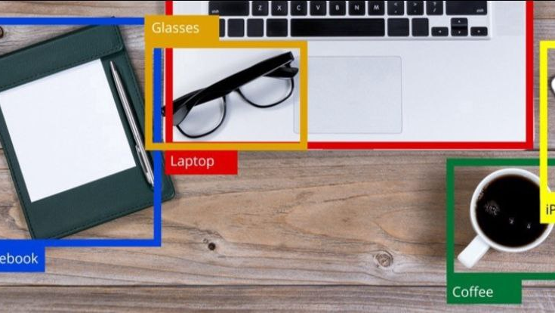
CONTEXT
In India every year nearly 4 to 5 lakh accidents happen .in those accidents almost 2 to 3 lakh people die.
Many of these accidents happen due to reasons like obstacles on the road and low visibility during night.
These minute human errors are making such huge losses to the society.

Slide 4
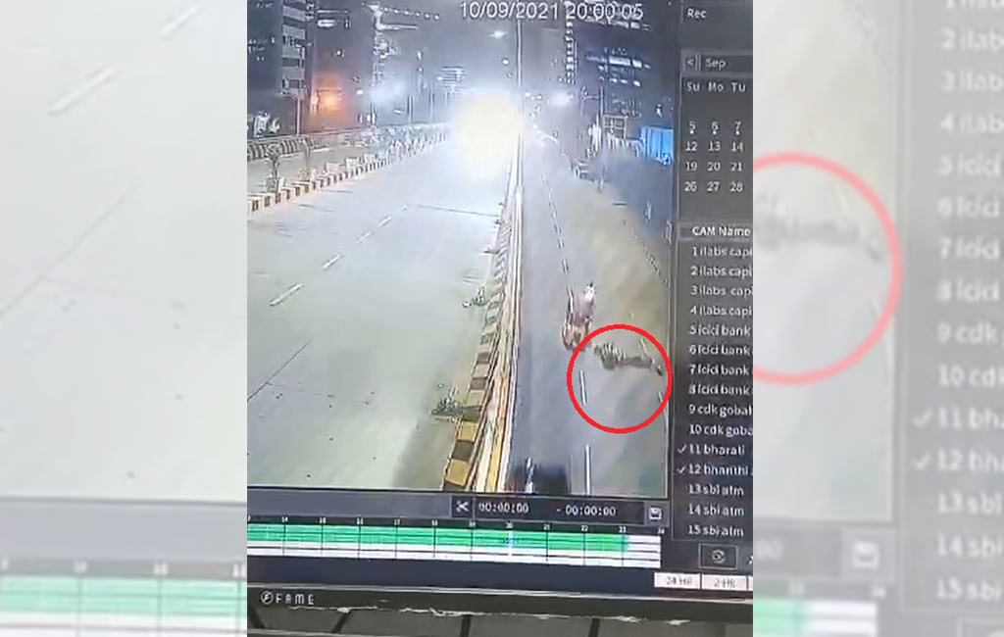
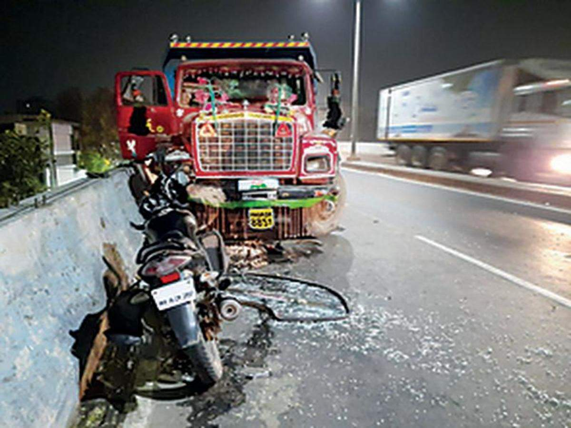

Slide 5
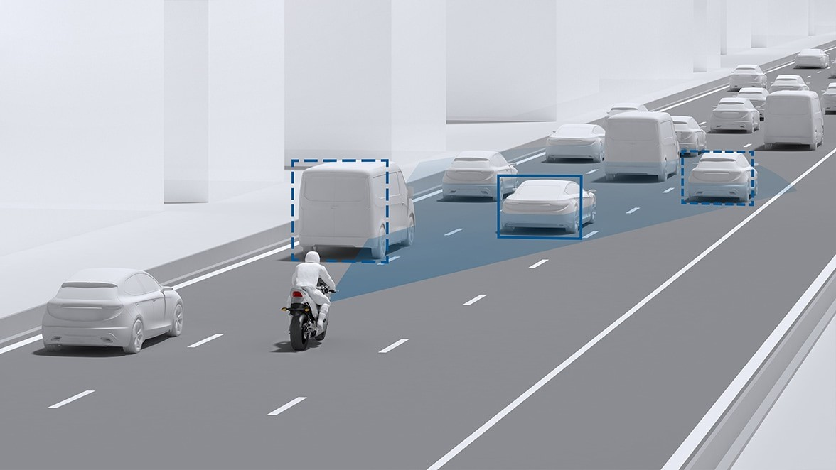
AI BASED TOOL TO ASSIST VEHICLES IN DETECTING OBJECTS TO AVOID ACCIDENTS

Slide 6
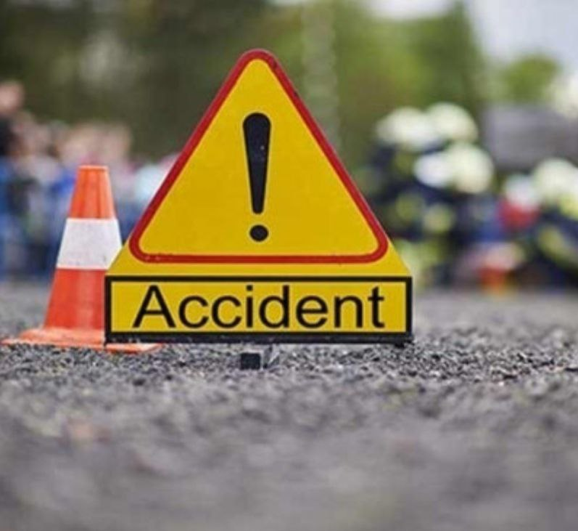
PROBLEM STATEMENT
On a survey ABOUT TWO WHEELER ROAD ACCIDENTS , WE CAME TO KNOW THAT UPTO 60% OF ACCIDENTS HAPPEN AT NIGHT TIME.
MOST OF THESE ACCIDENTS AR LEAD BY PITS ,SAND, ROCKS AND OTHER OBSTACLES ON THE ROAD.
DUE TO LOW VISIBILITY AT NIGHT TIME THESE OBSTACLES CAN’T BE SPOTTED BY THE RIDER.
TO OVERCOME THE ABOVE SCENARIOS THERE IS NO EXISTING TECHNOLOGY .
SO WE WANTED TO EXPLORE THIS PROBLEM THROUGH OBJECT DETECTION.

Slide 7
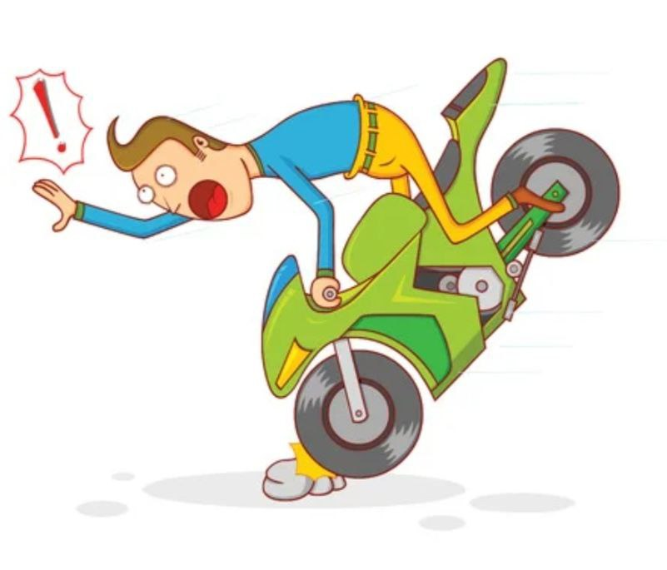
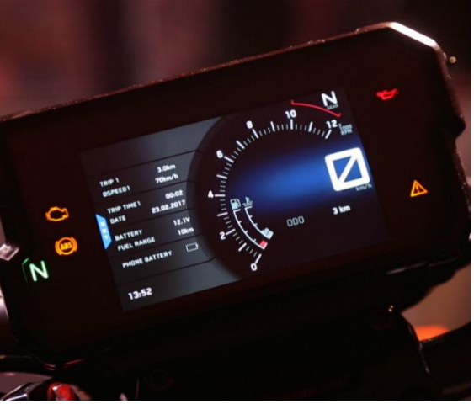
ABSTRACT :
The main purpose of this project is to build a object detector in vehicles to detect the obstacles(such as sand piles ,pits and rocks )
We want to indicate the obstacles by displaying obstacles on speed display meter
To convey the details of detected object in form of text message along with a voice command.

Slide 8
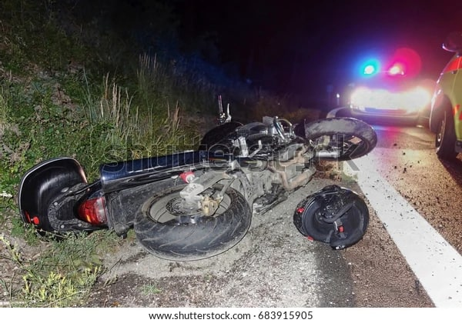
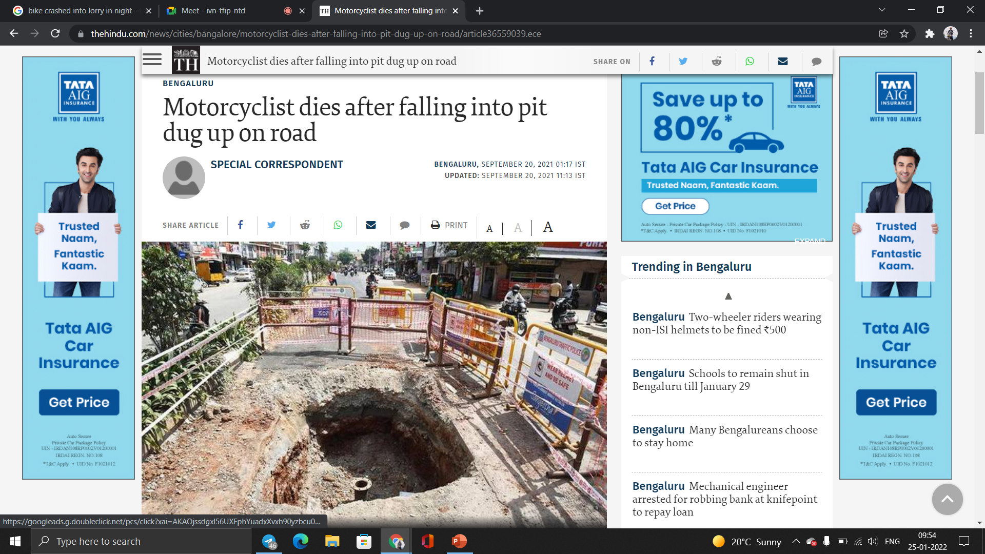

Slide 9


OUR APPROACH TO THE PROJECT

Slide 10
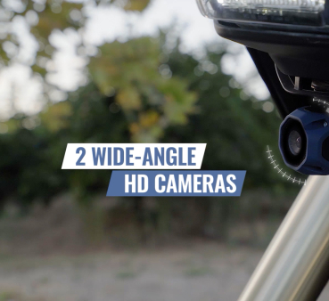
STEP 1-INPUT
THE INPUT IS CAPTIVATED FROM A CAMERA FIXED TO THE BIKE HEADLIGHT.
THE CAMERA USED WILL BE A 4k resolution WIDE ANGLED CAMERA FOR BETTER RESULTS.

Slide 11
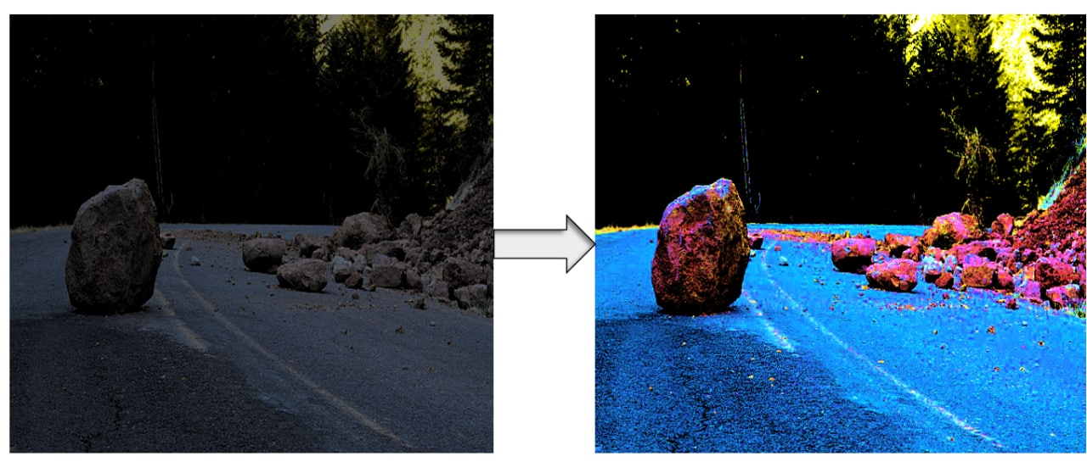
STEP 2- IMAGE ENHANCEMENT
THE IMAGE IS RECEIVED BY THE Arduino ACCOMPANIED TO THE CAMERA.
As the pictures are taken at night time, to enhance the clarity some changes(increasing brightness,contrast, adjusting saturation) are made.
THE IMAGE IS ENHANCED AND SENT FOR IMAGE PROCESSING .

Slide 12
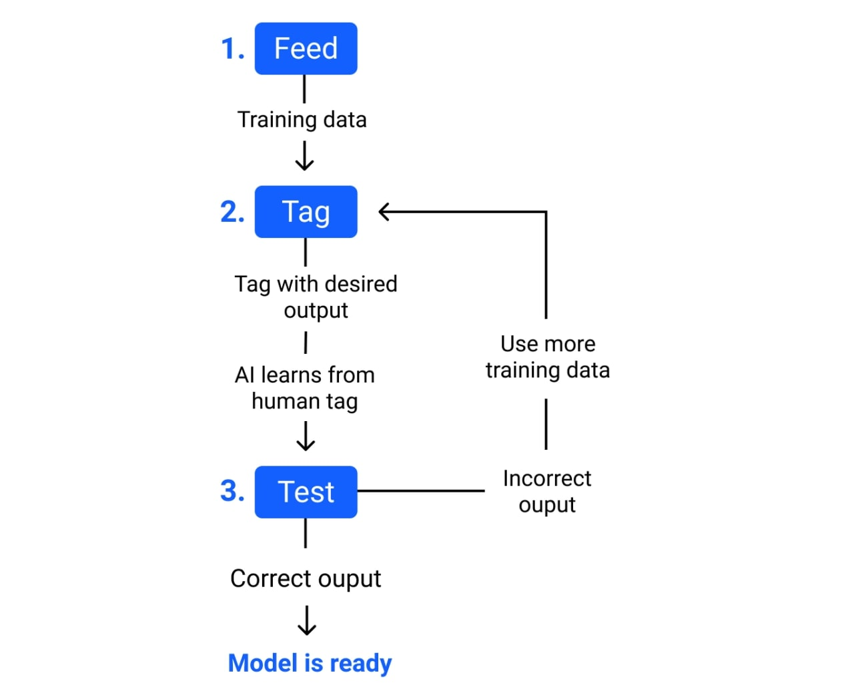
Step 3-Dataset training
Here we are going to train our software by providing proper datasets.
1. Feed a machine learning model training input data
2. Tag training data with a desired output. The model transforms the training data into text vectors – numbers that represent data features.
3. Test your model by feeding it testing (or unseen) data. Algorithms are trained to associate feature vectors with tags based on manually tagged samples, then learn to make predictions when processing unseen data.

Slide 13
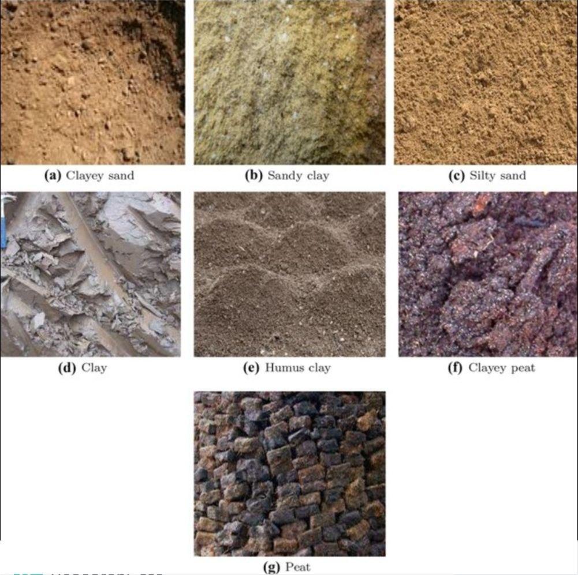
Images of few datasets

Slide 14
Flowchart of object detection

Slide 15
INPUT
IMAGE ENCHANCEMENT
Feeding images
Dataset loading
Dividing picture into blocks
DATASET TRAINING
Manual screening
Yes
Picture identification
IDENTIFICATION
AND DETECTION OF DATASETS
If fails
OUTPUT
Final dataset
Dataset comparsion

Slide 16
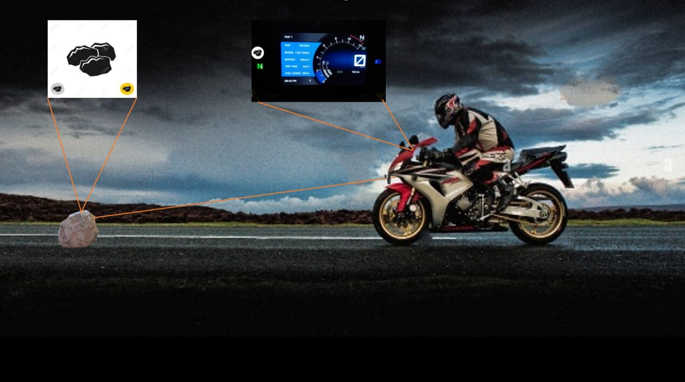
STEP-4 IDENTIFICATION AND DETECTION
THE PROCESSED IMAGE IS IDENTIFIED ACCORDING TO ITS DATASET (SAND, ROCKS AND PITS).
AS THE IMAGE IS IDENTIFIED THE INSTRUCTION IS GIVEN TO THE aurdino .

Slide 17
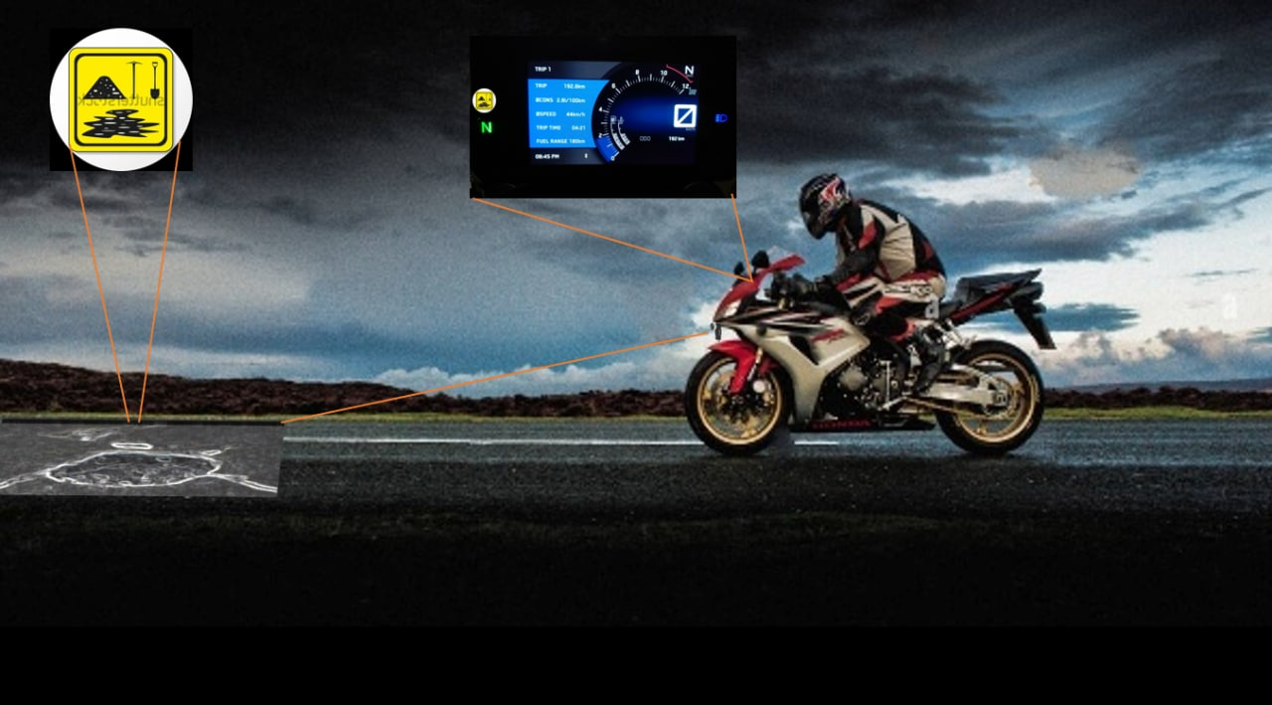
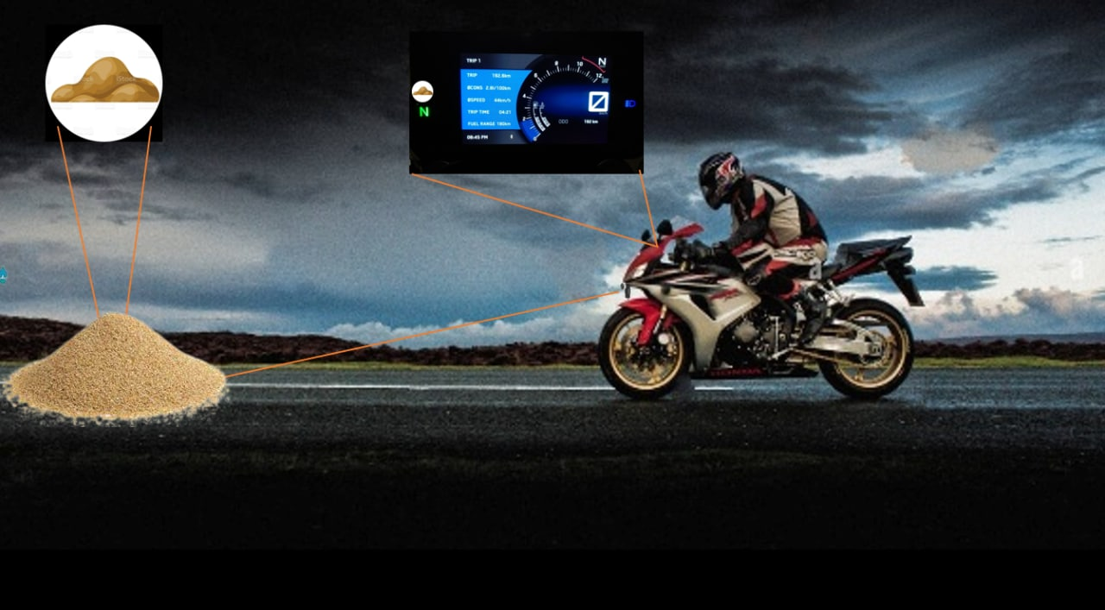

Slide 18
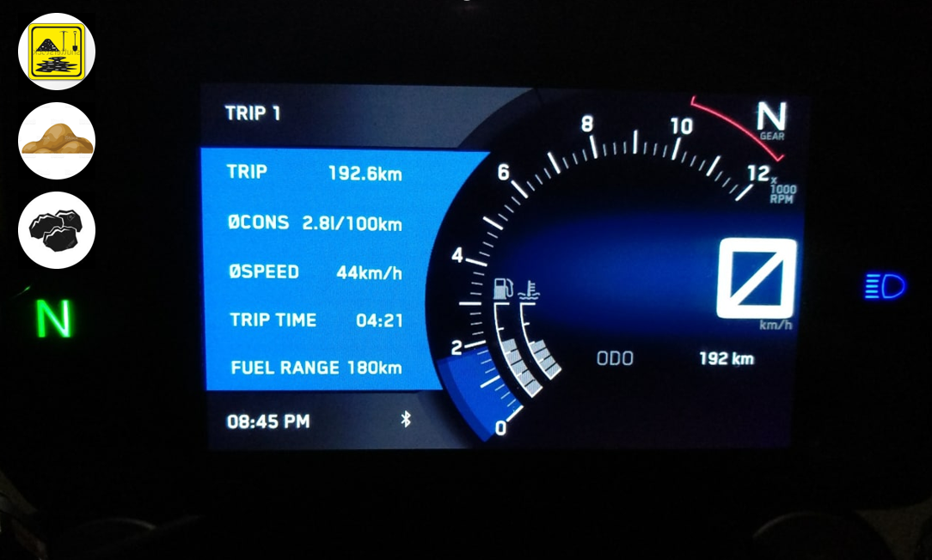
STEP-5 OUTPUT
THE SIGNAL IS CONVERTED INTO AN OUTPUT IN THE FORM OF PICTURE OR AN VOICE COMMAND.
THE PICTURE IS DISPLAYED ON THE SPEEDOMETER.

Slide 19
CONCLUSION
By choosing this topic, we have aimed to produce optimised solution for the obstacles that have come up in the experiments we have seen till date.
A product that can detect objects can be useful in road condition monitoring and prevent accidents .
Our attempt here is to try to develop a better solution for object detection in vehicles .
In addition to that we are also attempting to convey the info of detected objects to the rider in an efficient manner.

Slide 20


